Slide 1
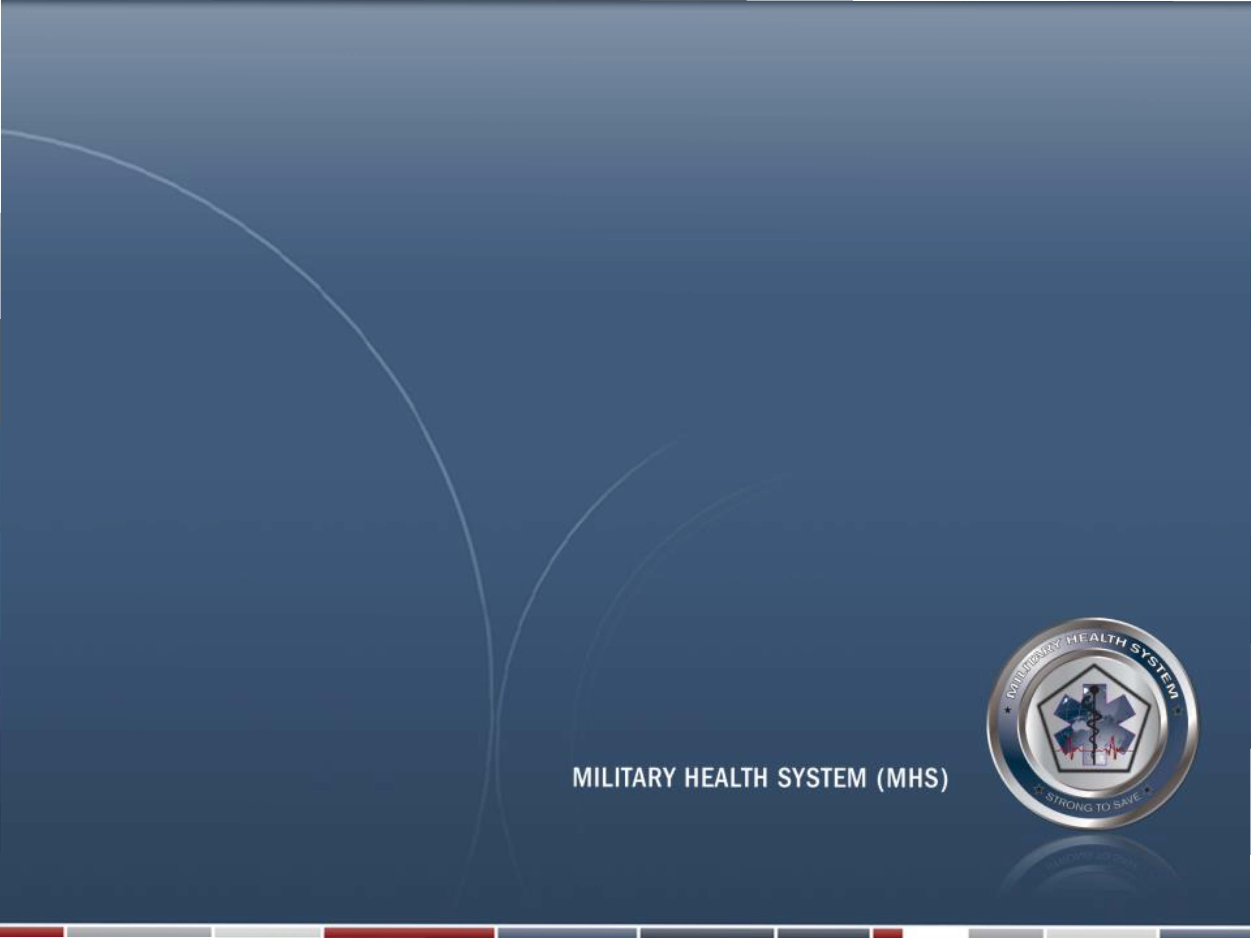
Snapshot of Defense & DHA Budget and Health IT Reform Implementation Plan
John Song
Madigan Clinical Informatics Fellow
14 August 2018

Slide 2

Briefing Overview Slide
Briefing Type
Informational
Briefing Overview (BLUF)
Defense and DHA Budget and Helath IT Reform Implementation snapshot/overview
Issue / Topic Routing Recommendation
Understanding of some budget aspects of Health IT enterprise level stackholders as budget = governance
Decision(s) Required
No decision required at this time
2

Slide 3
Outline
Defense FY19 NDAA
Defense FY18 NDS
DHA Budget
Health IT Reform Implementation Plan

Slide 4
FY19 Defense Budget Snapshot
President Donald Trump signed a $1.3 trillion dollar FY18 spending bill on 23 Mar 2018 and just signed $717 billion FY 2019 National Defense Authorization Act on 13 August 2018
Named for Az Sen. John McCain
Authorized a 2.6% military pay raise
Increasing force size including 4000 new active duty Servicemembers
FY2019 end strength for Army at 487,500; for Navy 335,4000; for Air Force 329,100; and for MC 186,1000
Funds 77 F-35 at $7.6 billion
Pending Congressional Appropriation/approval
$ in billions | FY 2017 Enacted | FY 2018 CR | FY 2019 Request | FY18 – FY19 Change
Base | 523.5 | 523.7 | 597.1 | +73.3
OCO | 82.5 | 83.4 | 89.0 | +5.6
Emergency Supplemental | -- | 4.7 | -- | -4.7
Total | 606.0 | 611.8 | 686.1 | +74.2

Slide 5
Defense Force Snapshot
FY18-19 AC End Strength
FY18-19 RC End Strength
Service | FY 2018* | FY 2019 | Delta FY18 - FY19
Army | 476.0 | 487.5 | +11.5
Navy | 327.9 | 335.4 | +7.5
Marine Corps | 185.0 | 186.1 | +1.1
Air Force | 325.1 | 329.1 | +4.0
TOTAL | 1,314.0 | 1,338.1 | +24.1
Service | FY 2018* | FY 2019 | Delta FY18 - FY19
Army Reserve | 199.0 | 199.5 | +0.5
Navy Reserve | 59.0 | 59.1 | +0.1
Marine Corps Reserve | 38.5 | 38.5 | --
Air Force Reserve | 69.8 | 70.0 | +0.2
Army National Guard | 343.0 | 343.5 | +0.5
Air National Guard | 106.6 | 107.1 | +0.5
TOTAL | 815.9 | 817.7 | +1.8
In thousands

Slide 6
FY2018 NDS
FY19 NDAA is derives from 2018 National Defense Strategy
Strategic Environment: Complex global security with Reemergence of Long-term, Strategic Competition (China, Russia, rogue regimes)
DOD objectives:
Defending the US homeland
Sustaining Joint Force
Deterrence
Enabling US interagencies
Maintaining favorable regional balance
Defending allies
Actions against adversaries
Preventing terrorists
Ensuring common domains
Delivering performances
Establishing 21st century National Security Innovation Base

Slide 7
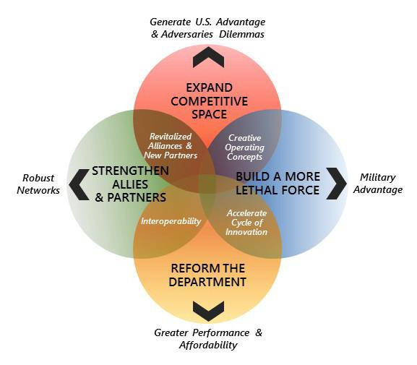
FY2018 NDS Cont
Strategic Approach: Expanding Competitive Space for US advantage & Adversaries Dilemmas
LOE1 Build a More Lethal Force: military advantage
LOE2 Strengthen Alliances and Attract Partners: robust network
LOE3 Reform the Department: Greater Performance & Affordability

Slide 8
Defense Health Agency Budget Background
DHA Budget
FY19 NDAA calls for $50.6 billion unified Budget servicing 9.5 million eligible beneficiaries
This is about par as FY 17 and 18
MHS focus (access, quality, safety, readiness, and experience of care):
Modernization of military health care system
Negotiating lower admin cost of TRICARE contracts
MHSG deployment
Health benefits reforms authorized by Congress
Reforming cumbersome processes
Streamlining internal ops
Transforming responsibilities of Military Department SGs to DHA per FY 2017

Slide 9
FY19 DHA Budget
65% of total care provided through tailored Contract, e.g. TRICARE

Slide 10
Healthcare Management Reform: Health IT Implementation Plan*
Background: Reform effort as mandated by previous CR since 2014 involving both DHA and Services undergoing comprehensive IT Reform analysis with pending savings….
Four Areas Identified For Efficiencies/Opportunities:
Create Shared Services: Included reengineering IT management, help desks, and portfolio rationalization (FY15-19)
Medical Network Modernization: IT optimization including Infrastructure, Cyber, Microsoft Windows (FY17-21)
Electronic Health Record (EHR) Modernization: MHS GENESIS replacement of legacy systems (FY18-22)
Reduce Manpower: Reduction in IT staffing footprint, elimination of duplicative IT systems, and consolidation of infrastructure and support capabilities (FY19-23)
MHS IT Reform Manpower Decrement By Component ($M)*
Component | FY19 | FY20 | FY21 | FY22 | FY23 | FYDP Total
Services | -16.6 | -95.2 | -148.5 | -150.3 | -107.2 | -517.8
DHA | -9.5 | -89.8 | -241.5 | -299.6 | -390.8 | -1,031.1
Total Decrement | -26.0 | -185.0 | -390.0 | -450.0 | -498.0 | -1,549.0
*As planned brief for 8 August 2018 to Reform Management Group

Slide 11

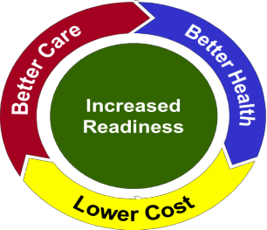

Health IT Reform Objective
Optimize information technology (IT) costs by reducing duplicative IT services and systems, reducing the IT manpower footprint across the Military Health System (MHS) enterprise, standardizing IT business processes and workflows to maintain and enhance quality of
patient care
Six Core Functions
Health IT Mission
Implement, manage, and sustain an integrated and protected medical information enterprise in order to ensure the right information is accessible to the right customers at the right time and in the right way.
Systems: Provide and sustain assigned enterprise systems being used across the MHS
Network: Provide and sustain the medical enterprise network upon which all the systems communicate (“Medical Community Of Interest” or Med-COI)
Budget & Portfolio Management: Portfolio management of assigned systems
Cyber: Defend and secure the
network
Innovation / Reform: Design and implement solutions leading to efficiencies to enable cost reductions of IT manpower, infrastructure, and applications
Customer Support: Provide enterprise help desk in support of the systems and network
Projected Health IT Reform Savings: $1.55B; beginning in fiscal year 2019 (FY19) President’s
Budget (19PB)
Pre-decisional/Deliberative

Slide 12
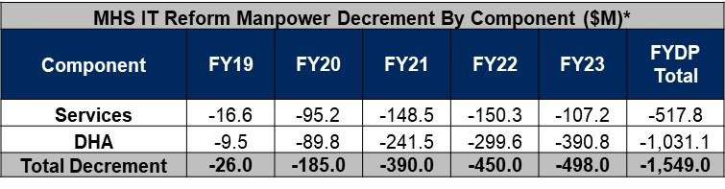
Current State of Health IT
FY 19: FY19 proportional spread of .838% decrement across Services and DHA
FY 20: Efficiencies based on functional applications, contract consolidation, and infrastructure
MHS IT Reform Decrement ($M) | -185
Service Decrements: | -95.2
DHA Decrements: | -89.8
Service/NCR Cuts ($M) | -95.2
Army DHP | -32.2
Navy DHP | -20.1
Air Force DHP | -11.9
NCR DHP | -31
DHA Cuts ($M) | -89.8
Contract Recompete Savings (New contract and no system enhancements for AHLTA) | -29.6
Delayed Refresh (Procurement for CHCS, CIS, HAIMS, VSSM) | -17.6
Contract Rationalization/Streamlining (PRMD and Bus Ops) | -5.5
Global Service Center Consolidation (Infrastructure) | -3
Reduction of On-Site Support due to Med-COI Efficiencies | -15.1
Economies of Scale gained from combining Non-Clinical and Clinical end user devices (EUDs) | -8.5
Active Directory Consolidation (shift of work from SPAWAR to DHA) | -4
Planned Infrastructure reductions in IT Services and IT Contract Consolidations | -6.5
Bus Ops = Business Operations
CHCS = Composite Health Care System CIS = Clinical Information System
DHP = Defense Health Program
HAIMS = Health Artifact and Image Management Solution PRMD = Portfolio & Resource Management Division SPAWAR = Space and Naval Warfare Systems Command VSSM = Veterinary Services Systems Management
Pre-decisional/Deliberative

Slide 13
Health IT Reform Challenges
Medical Network Modernization:
20% increase in scope of sites due to addition of non-clinical locations (e.g., Veterinary Clinics)
Installation of Defense Information Systems Agency (DISA) circuits twice as long as original estimates
MTFs unable to comply with Risk Management Framework (RMF) before Desktop to Datacenter (D2D)
fielding team arrival
Discovery of local unique equipment (non-standard) at hospitals
Lack of contracts and funding to support migration of non-standard equipment to new network
Underestimation of distributed equipment requiring touch labor
Window 10 migration took precedence and drove near term diversion of funds ($19M)
Electronic Health Record Modernization: Delay in MHS GENESIS deployment
Unable to sunset legacy systems on expected timeline
Increase in manpower needed to support both MHS GENESIS and legacy systems
Mandatory Upgrade To New Cyber Security Standard:
Department of Defense (DoD) upgrade to new RMF standard
Drives significant increase in workload and cost
Results: FY20, $58M delayed projected savings
Pre-decisional/Deliberative

Slide 14
Health IT Reform Implementation Plan LOE
Going Forward (FY 21 & Beyond): Three lines of effort will reduce duplicative IT services and
systems, reduce the IT manpower footprint and standardize IT business processes and workflows
Central Services | Reductions in manpower associated with the centralized shared services DHA provides D2D re-baseline • Data consolidation MHS GENESIS fielding • Rationalization Decommissioning • Cloud
Regional Services | Optimization of capabilities based on geography, time zone, and MTF density Cyber and RMF full time equivalent (FTE) consolidation Help desk restructure analysis
Military Treatment and Other Facilities | Reduction in manpower associated with standardization of capabilities Standard manning framework Standard missions and functions Funding adjudication process
1
2
3
Pre-decisional/Deliberative

Slide 15
Conclusion
Defense and DHA Budget (NDAA) plans are anticipated to be stable for next few years, reversing previous budget trends
Of National Defense Strategy (NDS), REFORM applies most critically to MHS
For Health IT, REFORM efforts involves 3 system-based LOEs

